Slide 1
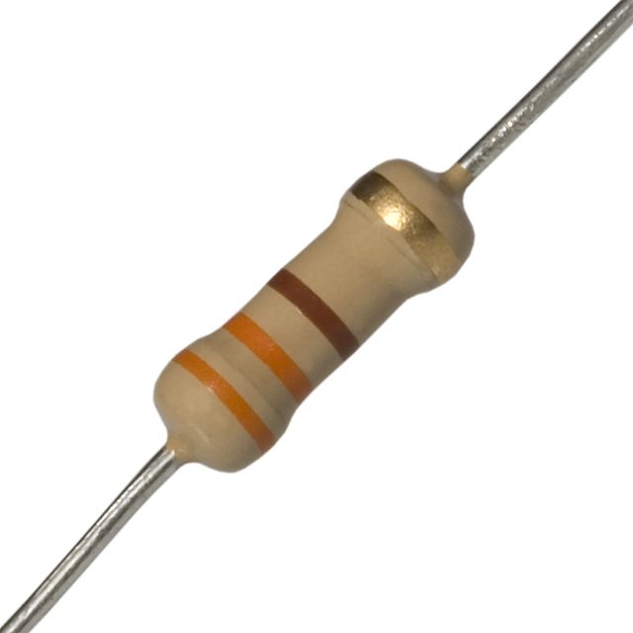
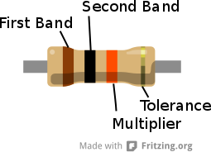
Resistor Worksheet
How do I do this?
By Instructor V. Bloom

Slide 2
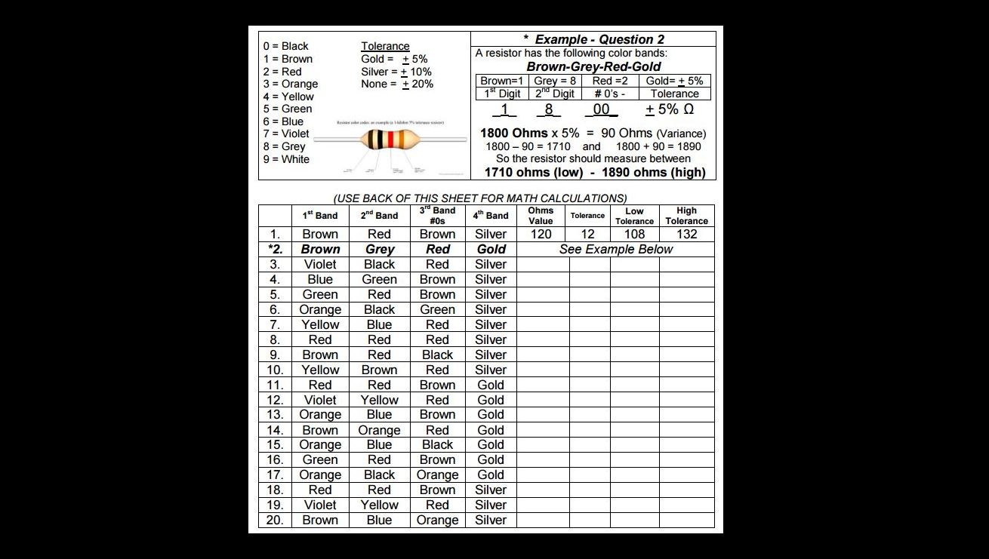
7

Slide 3
7
0

Slide 4
7
00
0

Slide 5
10% x 7000 = 700
7
00
700
0

Slide 6
7000 – 700 = 6300
7
00
700
6300
0

Slide 7
7
00
700
6300
7700
0
7000 + 700 = 7700

Slide 8
Questions?
Watch this power point again
Ask three other students
Ask a student tutor
Ask your instructor

